Slide 1


Work package 1
Making carbon- neutral hydrogen
Information session 9 November 2023

Slide 2
The Netherlands has the potential to play an important role
In international green H₂ developments –
for our society and economy

Slide 3

    Large offshore potential
Access to salt caverns
for large-scale storage
Ports
for import terminals
Strong knowledge basis from being a gas hub
Fight climate change
achieve net-zero in 2050 by reducing greenhouse emissions in non-electrifiable applications using green H₂
Boost earnings power
become a significant international player
in the green H₂ & chemistry economy, unlocking potential of NL high-tech sector
Retain key industries
within the Netherlands by facilitating their transition to net-zero in a sustainable way using green H₂ & chemistry
Improve business climate and energy security
by creating national green H₂ production capacity in parallel with import infrastructure
NL green H₂ potential
Export to Ruhrgebiet
Export to Antwerp
High-tech suppliers
Strong industry clusters
Existing gas infrastructure can be re-used

Slide 4
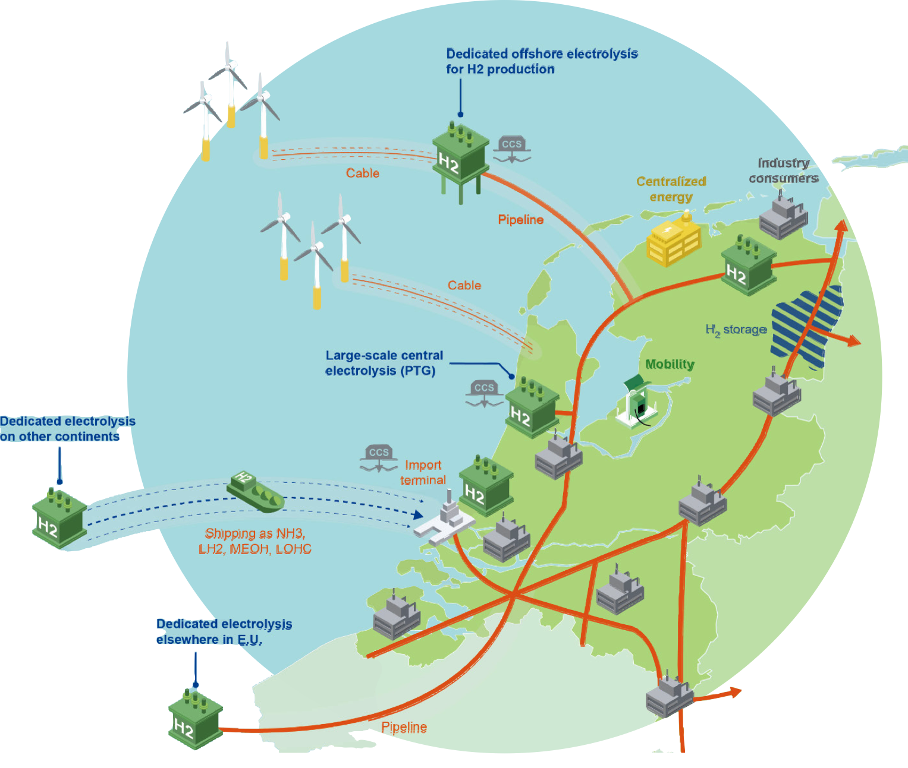
The Netherlands will become a green hydrogen hub
Production
Domestic onshore and offshore production initiatives
Large-scale central
Smaller-scale decentral International production for import
Dutch hydrogen hub
Roundabout
Hydrogen backbone
Large-scale storage options
Port import infrastructure
International interconnection capacity
Trading platform
Consumption
Current and new hydrogen consumers
Green high quality chemical products
Sustainable heavy transport

Slide 5




Groenvermogen instruments
50 M€
Human capital
National human
capital agenda
Regional learning communities
Digital platform
National coordination
R&D
7 work packages:
  Making carbon neutral H₂ (35 m€)
  Transport & storage of H₂
  Direct use of H₂
  Green H₂ & e⁻ for C-based chemistry
  Green H₂ & e⁻ for N-based chemistry
  Green H₂ & e⁻ for specialties
  Socio-economic aspects & H₂ implementation
Pilot support
Projects throughout the
value chains of production,
transport, storage and industrial use of green hydrogen (carriers).
  3-5 projects in H₂ value chain
  Small scale demonstration
  Regional testing facilities
Demo support
Support for the manufacturing industry
Demonstrating value chain projects
Feed/feasibility studies
Potential endurance testing facility
177 M€
100 M€
500 M€

Slide 6
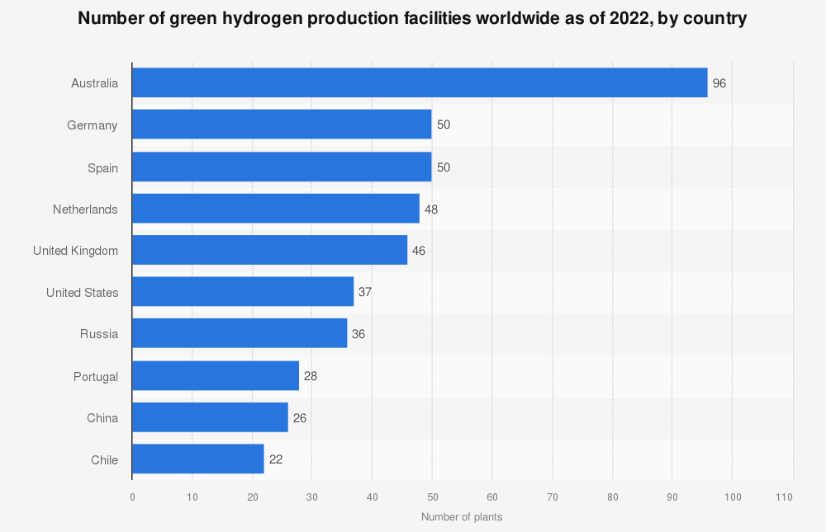
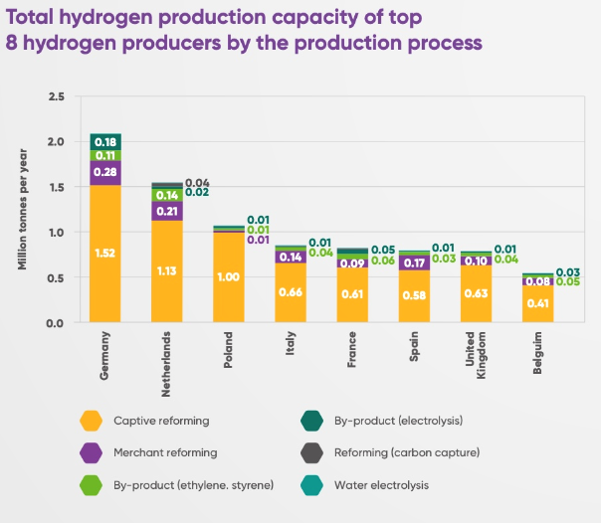
H₂ production capacity
Figures source: GlobalData; Energy Monitor
Water electrolysis is still in its infancy!
NL can play an important role
Figures source: Hydrogen Europe

Slide 7
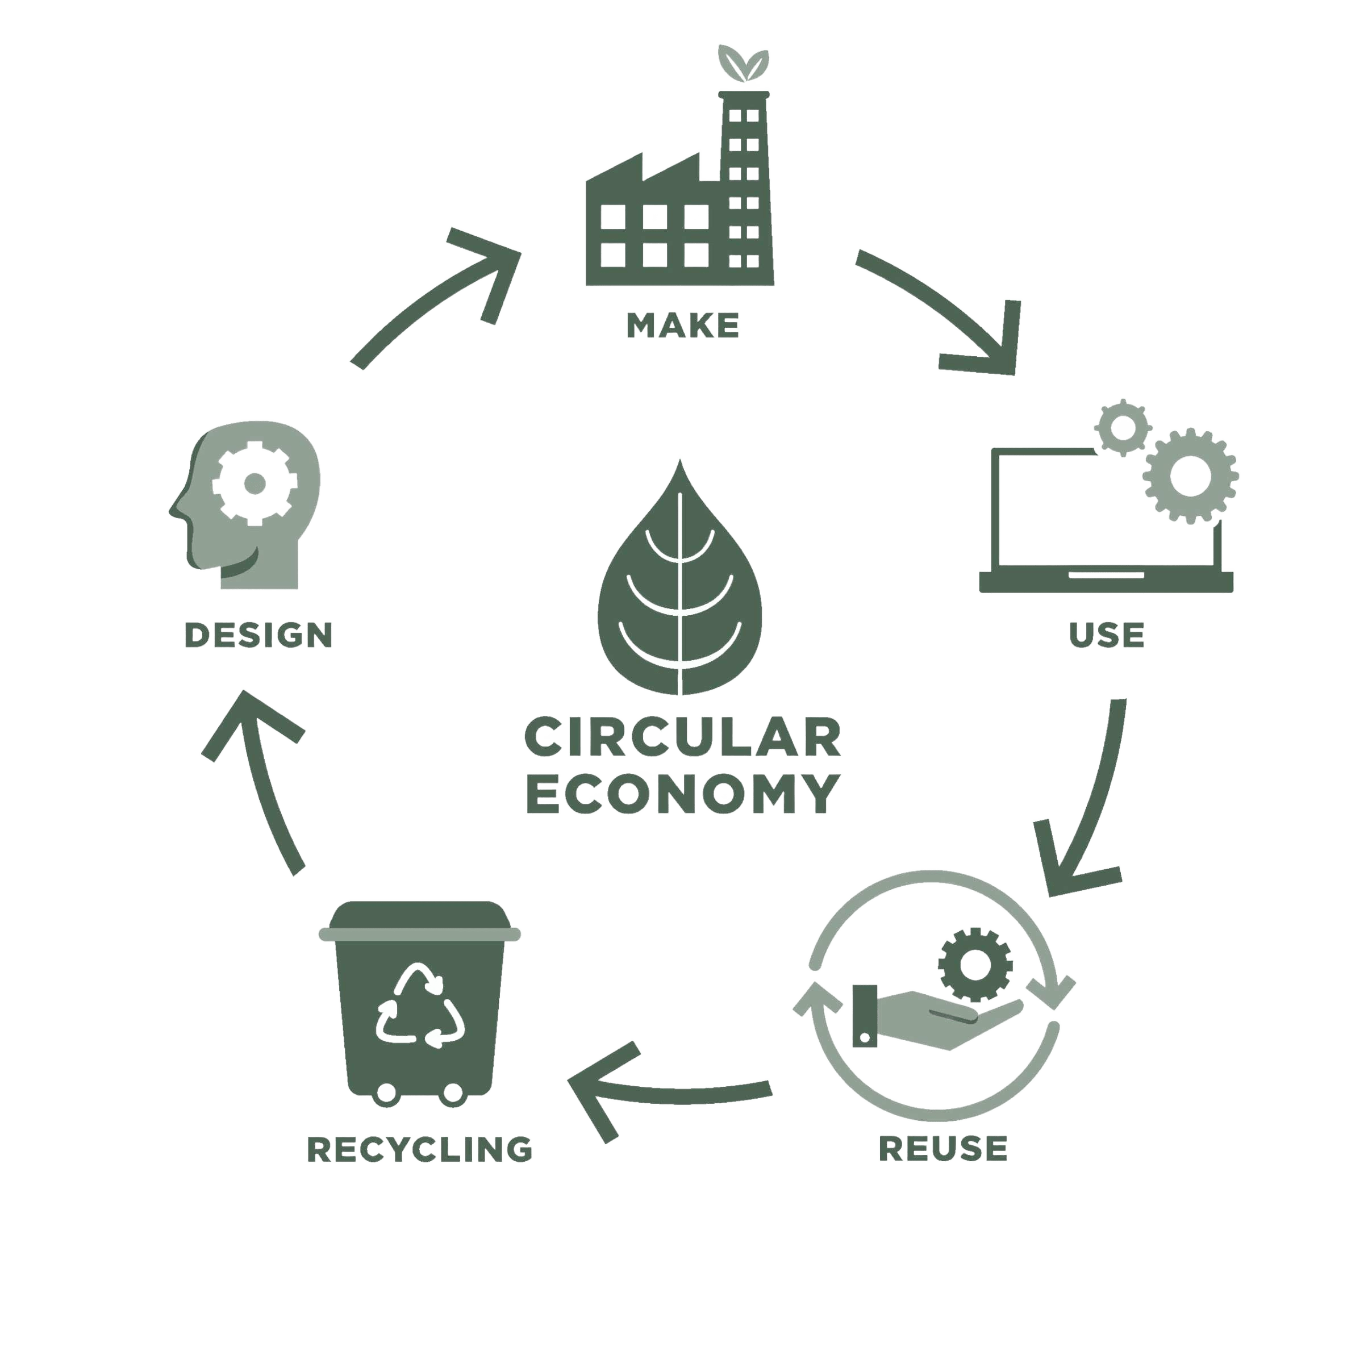
Which technologies?
 | Mid-term challenge | Long-term challenge
AWE | Lower cost of electrode manufacturing Increase current density through optimisation of catalyst (structure) | Highly active non-PGM catalyst Compact AWE through advanced micro- and nano-structured catalyst
PEM | Reduce the iridium loading by at least a factor 10 Low-cost, high-volume manufacturing (procedures + equipment) for MEA’s Improved (structured) membranes: thinner, chemically stable | Stable, iridium-free catalyst OER Fluor-free proton conducting membranes Innovative architectures on micro- and nano-scale to optimize the three-phase boundary
SOEC | Scaling-up cell size while maintaining mechanical strength Increase stability of materials and cells under electrolysis conditions Optimized manufacturing strategies (e.g., reducing number of sintering steps) Novel stack(ing) designs | Eliminate or radically reduce use of poisonous or “tainted” chemical compounds (e.g., cobalt) Novel methods for fabrication of stable ceramics with controlled porosity Novel materials for sealing and interconnect/separator plates
AEM | Stable anion conducting membranes Development of novel electrolyzer stacks including components (e.g., separator plates) | High temperature anion exchange membranes

Slide 8
Cost-efficient production of Green H₂
Other radical technologies
H₂
PEM
CAPEX (system) cost reduction (through innovation)
Reduce the use of scarce and expensive materials (e.g., iridium & platinum)
Improve circularity (e.g., PFAS free membrane)
Increase in conversion efficiency
System architectures in coupling with Balance of Plant
AEM
AWE
SOEC
Notes:
Hydrogen can be used in 5 different ways:
As a feedstock for industrial processes, e.g. oil refining or ammonia production. This is the primary use
As an energy carrier for mobility, from passenger cars to all types of heavy duty vehicles, trains or ships
As an energy carrier for the built environment as to supply heat/cooling and/or electricity;
As a fuel for high-temperature applications in industry (steel, cement, petrochemicals) replacing natural gas and other fossil fuels
As a fuel for power generation to balance the power grid.

Slide 9
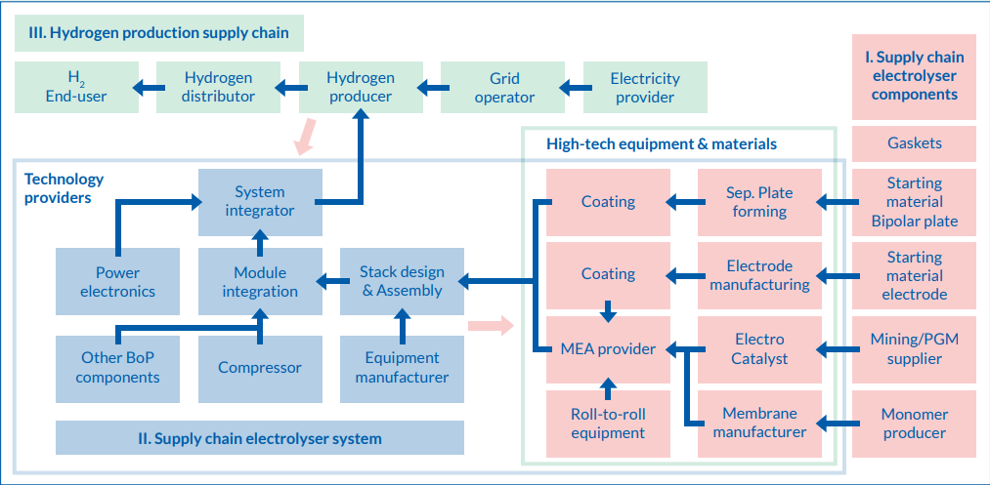
Supply chain electrolyser components
Source: TNO.

Slide 10
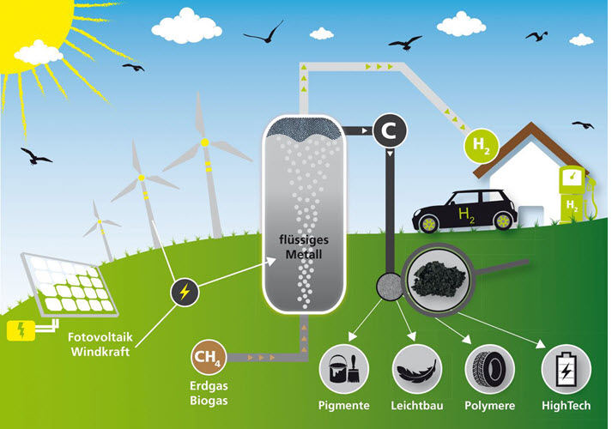
Pyrolysis: producing hydrogen without carbon emissions
H₂ Producing cost is comparable to conventional processes
H₂ production in large quantities
Valuable solid carbon is produced without the process releasing CO₂.
There is zero CO₂ emission in molten metal methane pyrolysis processes.
Key component of future climate-neutral energy supply!
Source: KIT.

Slide 11
WP1: Making carbon neutral hydrogen
R&D of AWE and PEM electrolysis technology, as well as the development of Dutch supply chains for materials, components and systems for AWE and PEM electrolysers.
Development, analysis and testing of technological innovations that improve the performance of AWE and PEM electrolysis technologies, including power electronics and compression as parts of the production chain.
R&D of new generation electrolysis processes, such as AEM and SOEC electrolysis, including radically new concepts.
R&D of CO₂-neutral hydrogen production from industrial residual gases.

Slide 12
Making carbon neutral hydrogen
NGF GroenvermogenNL R&D Programme WP1
www.nwo.nl/groenvermogennl
Gecombineerd - Information session GroenvermogenNL call WP1 09-11-2023.pptx
NWO | Information session 09-11-2023

Slide 13
New NWO procedure: GroenvermogenNL R&D WPs
Goal:
Facilitate the formation of a green hydrogen ecosystem in the Netherlands as effectively as possible
What is new?
  Innovative consortium building
    Two ‘pressure-cooker’ workshops with a diverse mix of representatives from academia, industry and government
  Funding of industry-driven R&D
    NWO funding for businesses and civil society organisations (up to 40%)
  Bringing together different types of stakeholders
    One jointly written full proposal

Slide 14
Timeline of the procedure for WP1
Deadline application for workshops
24 November 2023
Workshop 1
9-11 January 2024
Workshop 2
5-7 February 2024
Deadline proposal
25 April 2024
Interview with assessment committee
June 2024
Possibility for revision
1-2 months after request
Decision by NWO board
July 2024
Start of the project
No more than 6 months after formal award decision

Slide 15
Overview and time scheme
Proposal
24 November 2023, 14:00 CET | Deadline Application form
9-11 January 2024 5-7 February 2024 | Workshops
25 April 2024, 14:00 CEST | Deadline proposal
June 2024 | Interview and meeting assessment committee
July 2024 | Decision by the NWO board
No more than 6 months after the date of the formal award decision | Starting date of the project

Slide 16
Workshops
2 x 2,5 day
  Apply for participation (ultimately 24 November 2023)
  One representative per organisation
  9-11 January and 5-7 February 2024
  No guarantee for funding, but…
  Join if you want to be in and want to help shape the project
  Partners may join later during writing process, but only on invitation of the consortium
  Procedure will be guided by professional moderators and independant experts in the field
  Leadership
  Two persons: project leader and technical manager
  Consortium will choose leadership during 1st workshop from attendants
  Optional: task leads

Slide 17
What can be applied for?
Available NWO/Growth Fund budget: € 34.512.627, for one proposal maximum
Funding other than by NWO
Minimal 30% of the total project budget
Co-funding: in cash (excl. Dutch VAT) or in-kind co-funding by businesses and civil society organisations
The own contribution from businesses and civil society organisations (i.e. the non-funded part of their subsidized costs (60%))
Minimal 50% of the NWO/Growth Fund budget should go to research organisations
Notes:
Maximum, minder ook mogelijk indien gewenst.

Slide 18
Who can apply/ consortium partners
(Co-)applicants
  (Employees of) research organisations (NWO-acknowledged + univ app sc + TO2) 100% funding
  (Employees of) businesses and other public and private organisations (companies and societal organisations) 40% funding
    Min 0,6 fte tenured position + at least master degree + organisation has R&D activities in NL

Slide 19
The consortium
Types of participants
  (Co-)applicant
    Research organisations: 100% funding
    Business or civil society (public) organisations: 40% funding
  Co-funder (in kind/in cash)
    If co-applicant as well: only in-kind cofunding is allowed
  Collaborative partner
    Involved in conducting research and of knowledge utilisation
    Receive no funding + contribute no cofunding
  Project lead
  Project lead is chosen by the consortium during the workshops
  Main applicant/ project leader (from (co-)applicant cat. 1)
  Technical manager (from (co-)applicant cat. 1 of 2)
  If you have interest in being the project lead: please indicate on the application
  form for the workshops

Slide 20
The consortium
(Co-)applicant
Collaborative partner
Co-applicant & Co-funder
Co-funder

Slide 21
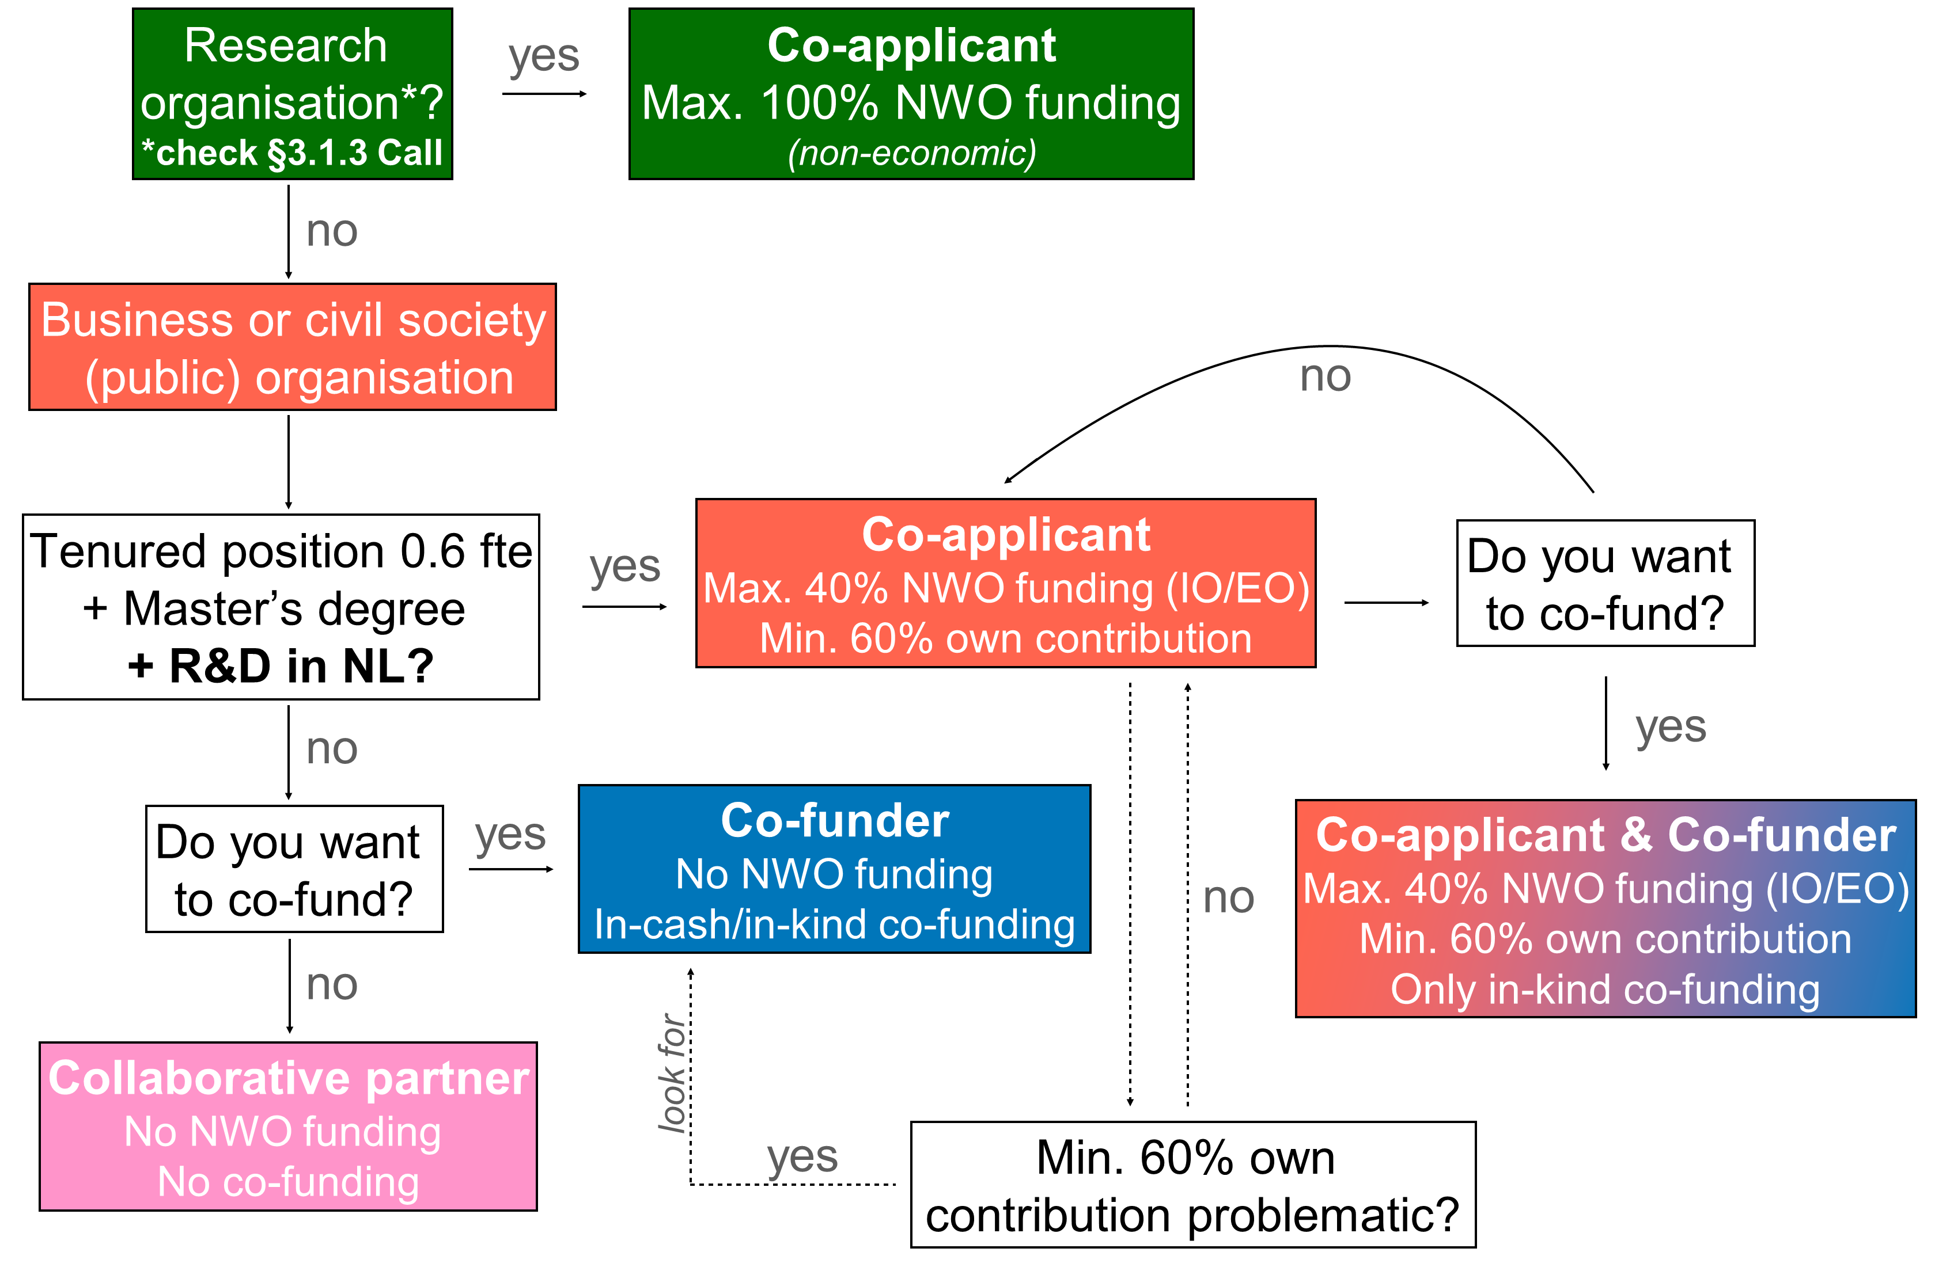
Which type of consortium partner?

Slide 22
Min. 60% own contribution problematic?

Slide 23
GBER (AGVV)
NWO funds project proposals in this Call for proposals in accordance with article 25 of the GBER (support for research and development projects) for the activities of businesses and civil society organisations.
No funding for
  businesses against which a certain* recovery order is outstanding
  businesses that are in certain* difficulties
  Accumulation of grants (or other forms of state support) for the same – entirely or partially overlapping – costs that are eligible for funding may not lead to exceeding the maximum support intensity for research and development projects
  Statement General of the GBER is mandatory
* see details in the call text

Slide 24
Funding of personnel costs
Tariff systems
  UNL rates + 50% premium
  NFU rates + 50% premium
  HOT rates + 50% premium
  Rate according to integral cost system (IKS) as registered at RVO for the organisation of the concerned main or co-applicant.
  A fixed hourly rate of 60 euros
Research organisations: 1, 2 or 4 (except HBO/TO2: 3 or 4)
Businesses and civil societal organisations: 3, 4 or 5

Slide 25
How will the proposal be assessed? (1)
NWO
Does the proposal & budget meet the formal requirements of this call?
  If not, NWO will contact main applicant (within 2 weeks after deadline) to correct
Notes:
Mondeling toevoegen wat quality consortium en research plan is.

Slide 26
How will the proposal be assessed? (2)
Independent assessment committee
Research organisations: non-economic activities? (yes/no)
How good is the quality of the consortium? (grade, 50%, treshhold score)
  Expertise, composition, governance structure, active participation, HCA
How good is the quality of the research plan? (grade, 50%, treshhold score)
  Urgency, choices, scientific and methodological quality, feasibility, impact
Interview with assessment committee
Revision of the proposal
Is the committee’s advice not to award funding? There will be one opportunity for revision, for which you will have one month time(two months if the advice is to include more organisations as co-applicants, co-funders or collaborative partners).
Notes:
Mondeling toevoegen wat quality consortium en research plan is.

Slide 27
Obligations for grant recipients
Substantive monitoring
  Regular project meetings organised by the consortium and GroenvermogenNL
  Project leader and technical manager in advisory committee to the GroenvermogenNL board
  Supervisory committee
Accountability during the project
  Annual substantive and financial reports to NWO; to be shared with GroenvermogenNL board
Completion of the project
  Auditor’s statement for the entire project

Slide 28
Funding conditions
All results must become publicly accessible
Generated knowhow is not exclusive for any of the parties!
No unauthorised state support allowed (in the sense of article 107 of the Treaty on the Functioning of the European Union)
Declaration GBER (for businesses), to be submitted along with the proposal
Co-funding statement (for co-funders), to be submitted along with the proposal
Consortium agreement on IP & publication procedure (to be concluded within 6 months after granting!)

Slide 29
Summary
Check your position within the consortium
  Co-applicant
    Research organisation: 100% NWO funding
    Business or civil society (public) organisations: max. 40% NWO funding, min. 60% own contribution
    Check GBER (AGVV)!
  Co-funder (in kind/in cash)
  Collaborative partner
Attendance workshops
No guarantee to receive funding, but
Join if you want to be in and want to help shape the project
Assessment criteria proposal
Research organisations: non-economic activities?
How good is the quality of the consortium?
How good is the quality of the research plan?

Slide 30
Timeline of the procedure for WP1
Deadline application for workshops
24 November 2023
Workshop 1
9-11 January 2024
Workshop 2
5-7 February 2024
Deadline proposal
25 April 2024
Interview with assessment committee
June 2024
Possibility for revision
1-2 months after request
Decision by NWO board
July 2024
Start of the project
No more than 6 months after formal award decision

Slide 31
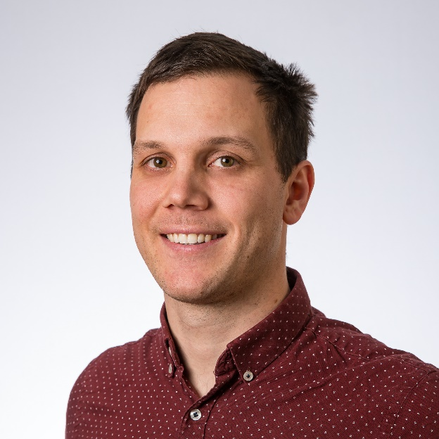

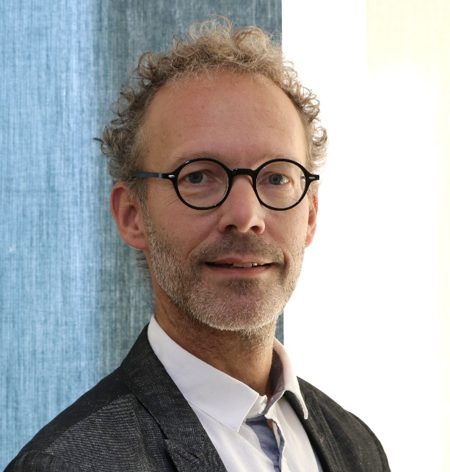
Questions? Ask us!
Leon Leu
+31 6 1395 2854
Maarten de Zwart
+31 70 344 0697
GroenvermogenNL_WP1@nwo.nl

Slide 32
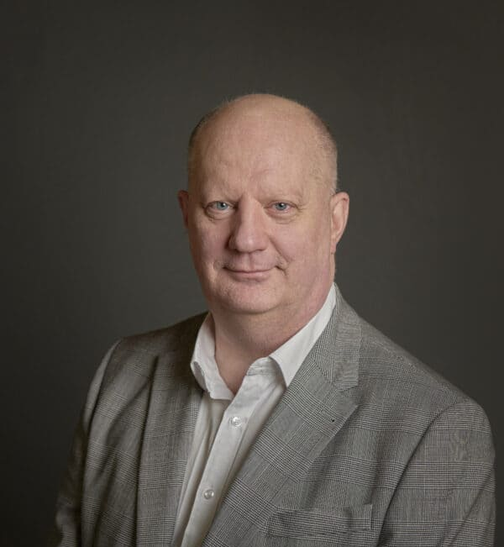

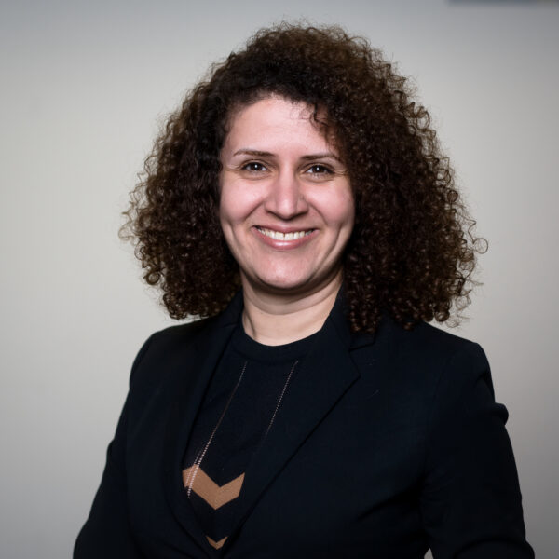

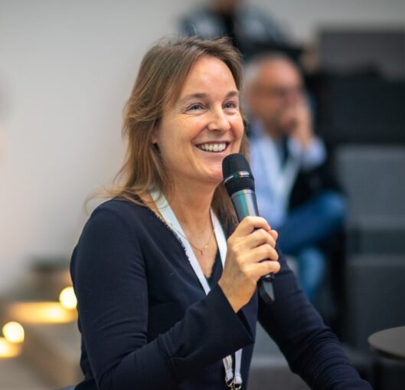
Questions?
Ed Buddenbaum
Sr. Program Manager
General affairs, Pilots & Demonstrations
Maarten de Zwart
Sr. Program Manager NWO
Maryam Alimoradi Jazi
Program Manager
R&D
Leon Leu
Program officer NWO
Marsha Wagner
Program Director
HCA

