Slide 1
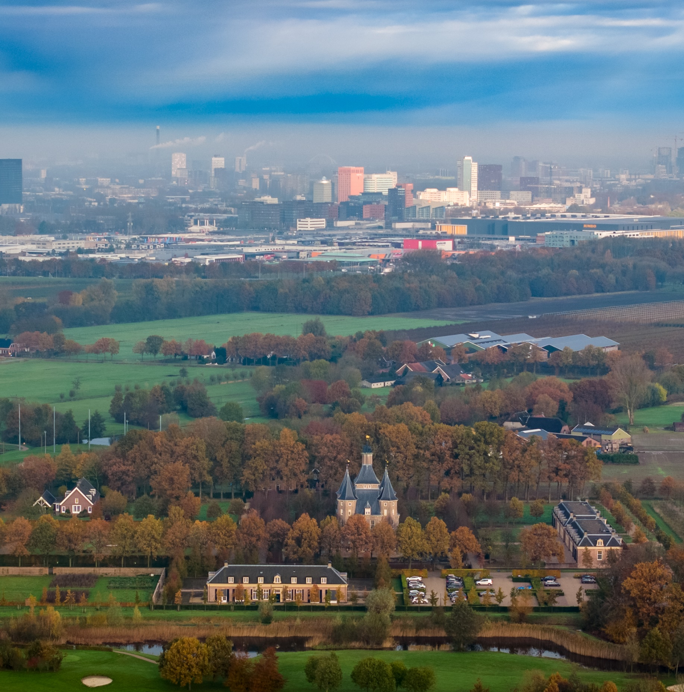

Slide 2
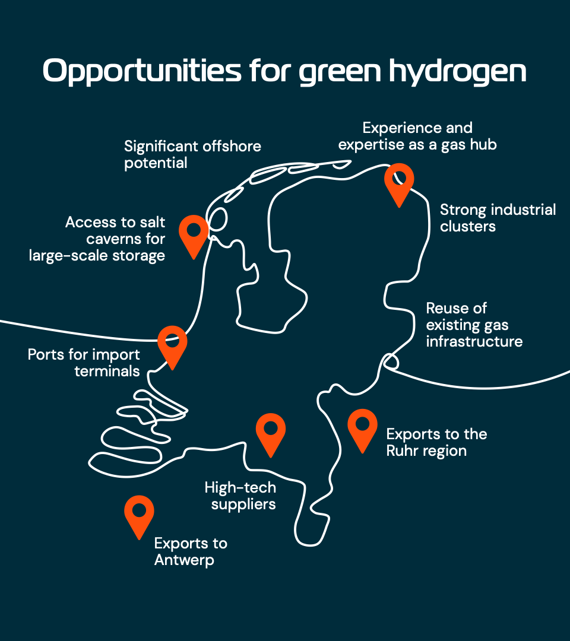
Fight climate change
achieve net-zero in 2050 by reducing GHG emissions in non-electrifiable applications using green H₂
Boost earnings power
become a significant international player
in the green H₂ & chemistry economy, unlocking potential of NL high-tech sector
Retain key industries
within the Netherlands, by facilitating their transition to net-zero using green H₂ & chemistry
Improve business climate and energy security
by creating national green H₂ production capacity in parallel with import infrastructure

Slide 3
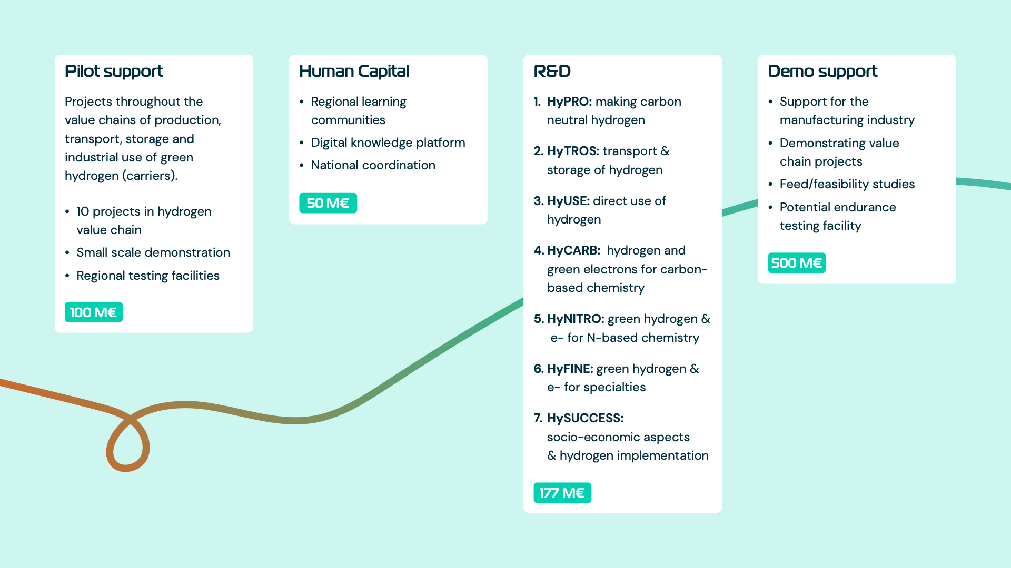

Slide 4
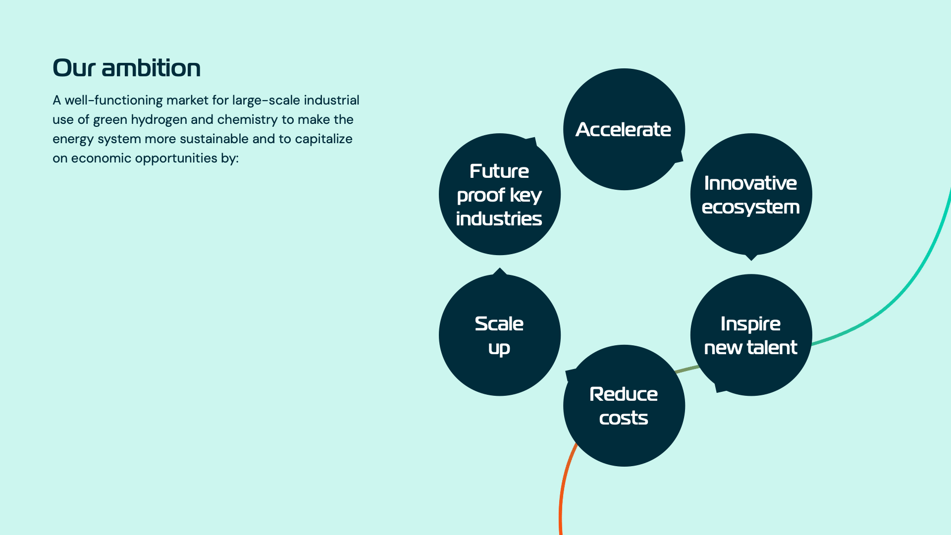

Slide 7
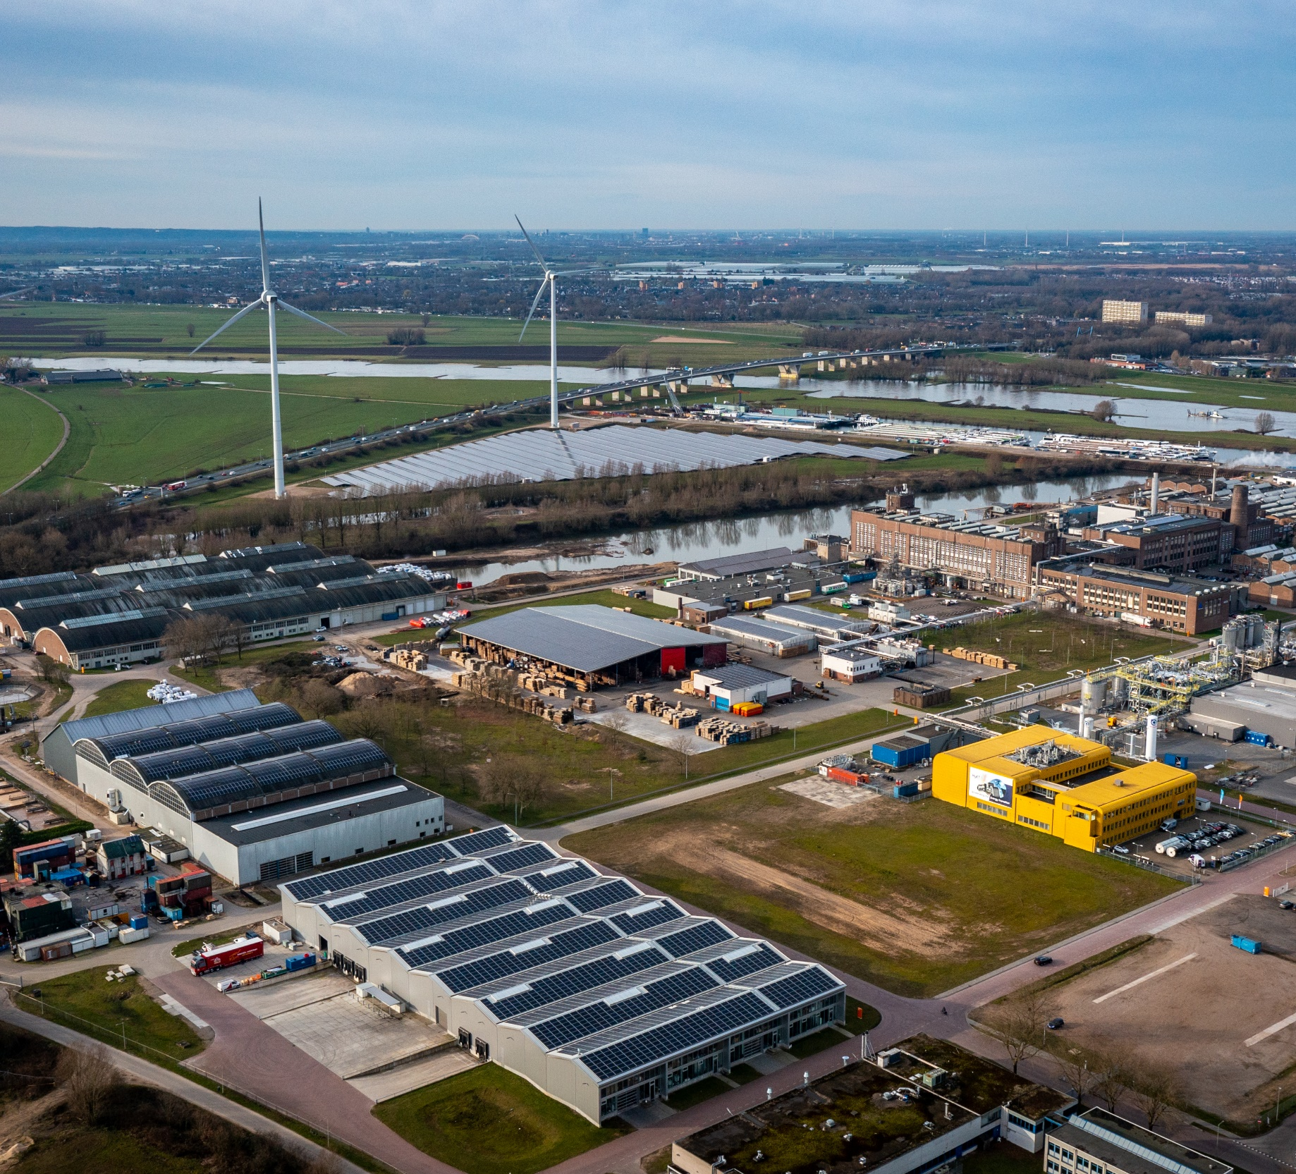

Slide 9
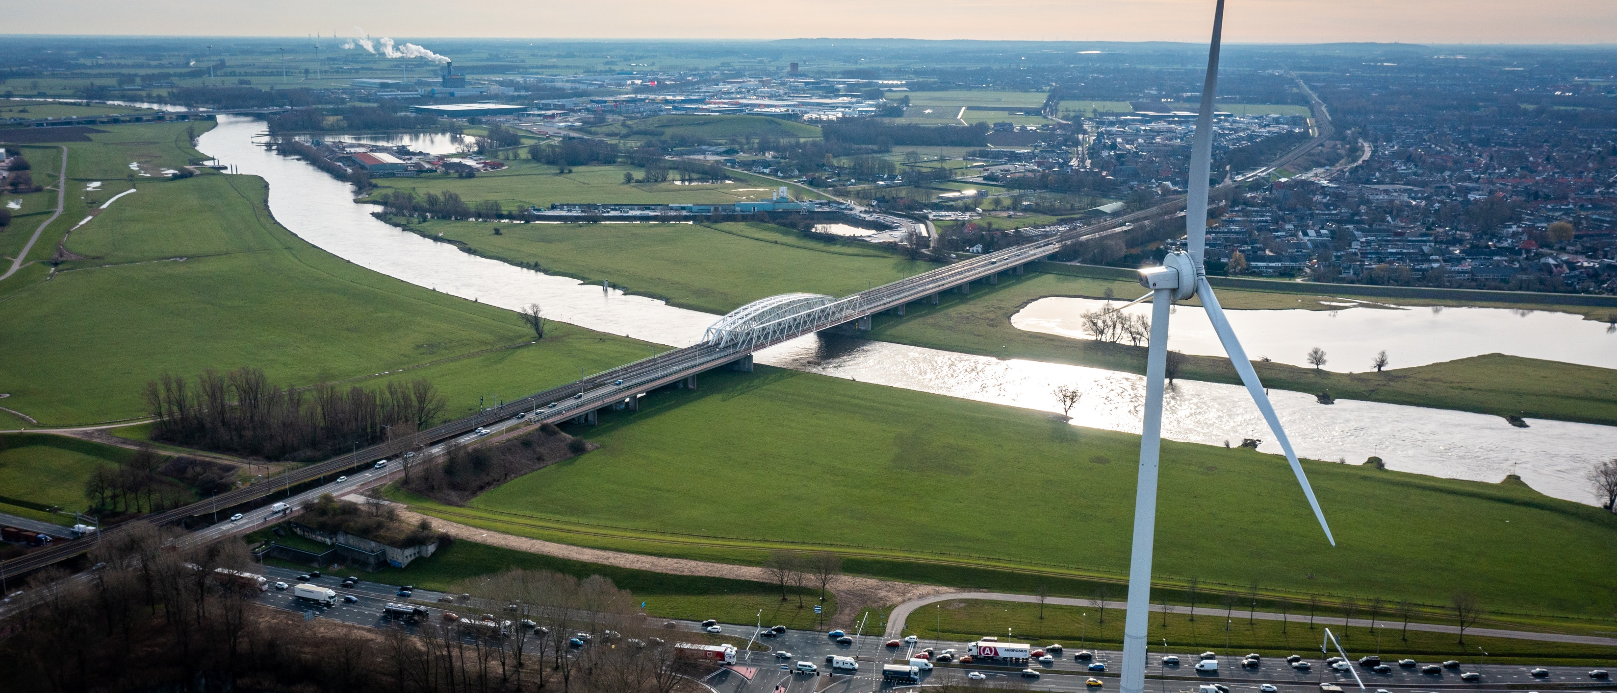

Slide 13
Titel
Titel
Onderwerp:
  Inhoud
Titel
Onderwerp:
  Inhoud
Titel
Onderwerp:
  Inhoud

Slide 20
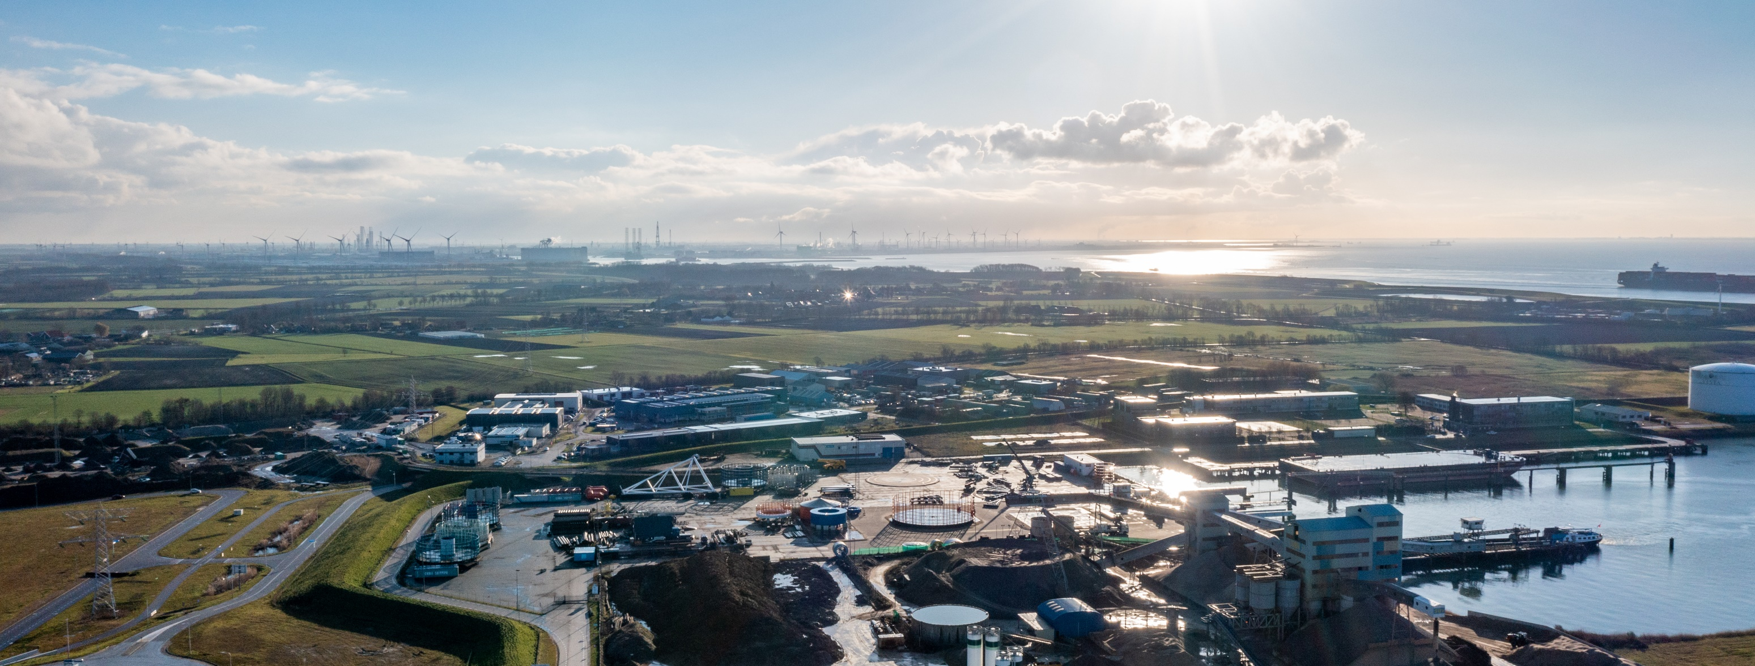

Slide 21
Naam
Functie
Email@email.nl

Slide 22
